Slide 1
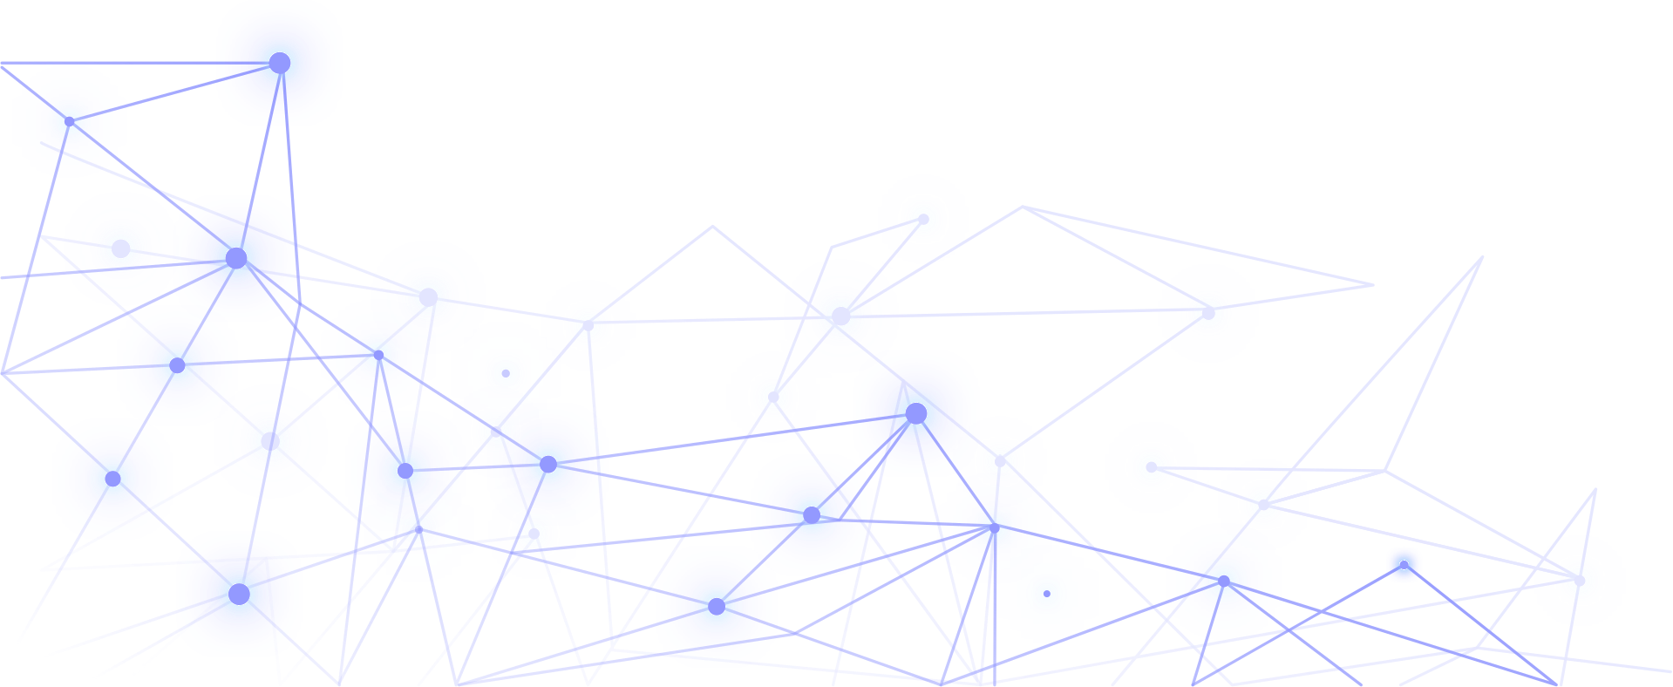
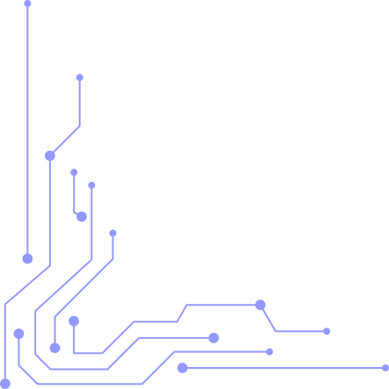
ADAPTIVE DETECTION OF ADVANCED PERSISTENT THREATS (APT) WITH GRAPH NEURAL NETWORKS AND REHEARSAL-BASED CONTINUAL LEARNING ON WAZUH EDR TELEMETRY
AM.SC.U4CSE23214: Chaitanya Krishna
AM.SC.U4CSE23219: Tejaswini
AM.SC.U4CSE23236: Guna Abhiram
AM.SC.U4CSE23272: Chetan Krishna
Coordinator: Dr. Nimmy K || Guide: Dr. Swapna MP
Department of Computer Science and Engineering
Amrita School of Computing, Amritapuri Campus

Slide 2
Introduction and Background
Domain Overview:
Advanced Persistent Threats (APTs) are stealthy, long-duration cyber attacks.
Attackers continuously evolve attack patterns to bypass security systems.
Enterprise Detection and Response (EDR) telemetry generates large-scale network activity logs.
Importance of the Problem:
Traditional Intrusion Detection System (IDS) systems fail to adapt to evolving attack behaviors.
Static machine learning models suffer from performance degradation over time.
Detecting coordinated malicious communication patterns is difficult using flat feature-based methods.
Motivation Behind the Research:
Graph Neural Networks (GNNs) can capture relationships between network entities.
Continual Learning allows models to adapt to sequential attack evolution.
Rehearsal replay helps preserve knowledge from previous attack distributions.

Slide 3
Research Problem Definition
Problem Addressed in the Paper:
Detecting evolving APT attacks from sequential Wazuh EDR telemetry data.
Maintaining detection performance across changing network traffic distributions.
Existing Challenges
Catastrophic forgetting in sequential learning.
Dynamic attack behavior and temporal distribution shift.
Large-scale graph processing complexity.
Inability of classical models to model communication topology.
Objectives of the Proposed Work:
Convert network telemetry into graph structures.
Use GNNs for structural threat detection.
Apply rehearsal-based continual learning.
Improve adaptability to evolving cyber threats.

Slide 4
Literature Review / Existing Methods
Previous Approaches:
Signature-based Intrusion Detection Systems
CNN and RNN-based intrusion detection
Deep Neural Networks
Static anomaly detection methods
Research Gap Identified
Limited use of graph-based cybersecurity learning.
Lack of continual learning mechanisms in IDS systems.
Need for adaptive models capable of handling evolving APT behaviors.
Limitations of Existing Systems:
Treat each flow independently.
Ignore communication relationships between IPs.
Poor adaptation to unseen attacks.
No memory retention across sequential tasks.

Slide 5
Proposed Methodology in the Paper
Overall Architecture / Framework:
Workflow of the Proposed System:
Network flow records are transformed into graph nodes.
Edges represent communication relationships.
GNN models learn structural attack behavior.
Replay buffer preserves previous task knowledge.
Data preprocessing
Feature normalization
Temporal task division
Graph construction
GNN training
Replay-based continual learning
Evaluation and analysis
Main Techniques Used
Graph Convolutional Network (GCN)
Rehearsal-Based Continual Learning

Slide 6
Tools, Technologies, and Dataset Used
Software and Libraries:
Dataset Description:
Python 3
PyTorch
PyTorch Geometric
Scikit-learn
Pandas and NumPy
NetworkX
Matplotlib and Seaborn
Dataset Used:
APT Dataset (Kaggle substitute for Wazuh telemetry)
Dataset Statistics:
Total Records: 1,671,272
Total Features: 85
Node Features Used: 80
Benign Flows: 799,358
Malicious Flows: 871,914
Programming Language / Framework
Programming Language: Python
Deep Learning Framework: PyTorch
Graph Framework: PyTorch Geometric
Runtime Environment: Google Colab

Slide 7
Implementation Details
Modules Developed:
Data preprocessing module
Graph construction module
Baseline model implementation
GNN training module
Replay buffer module
Evaluation module
System Design / Block Diagram
Graph Construction:
Each network flow becomes a node.
Edge Types
Key Implementation Steps:
Same Source IP edges
Same Destination IP edges
Temporal adjacency edges
Temporal sorting of flows
Sequential task splitting
Feature scaling using StandardScaler
Replay memory integration during training
Task-wise evaluation after continual learning

Slide 8
Experimental Setup and Evaluation Metrics
Hardware / Software Environment
Performance Metrics Used
Google Colab
PyTorch + PyTorch Geometric
Accuracy
Precision
Recall
F1-Score
ROC-AUC
Confusion Matrix
Forgetting Score
Testing Procedure
Dataset divided into 5 sequential tasks
Training performed task-by-task
Replay buffer used during later tasks
Evaluation performed after each task

Slide 9
Results and Analysis
Experimental Results:
Random Forest:
Mean Accuracy: 95.84%
Severe degradation in Task 5
Interpretation of Results:
MLP:
Tasks 1–4 showed stable performance.
Task 5 introduced major distribution shift.
Classical models produced many false positives.
GNNs better captured evolving communication behavior.
Mean Accuracy: 95.64%
Similar distribution shift problem
GNN Models:
GCN + Replay: ~98.5%
GraphSAGE + Replay: ~99%
GAT showed strong structural learning capability

Slide 10
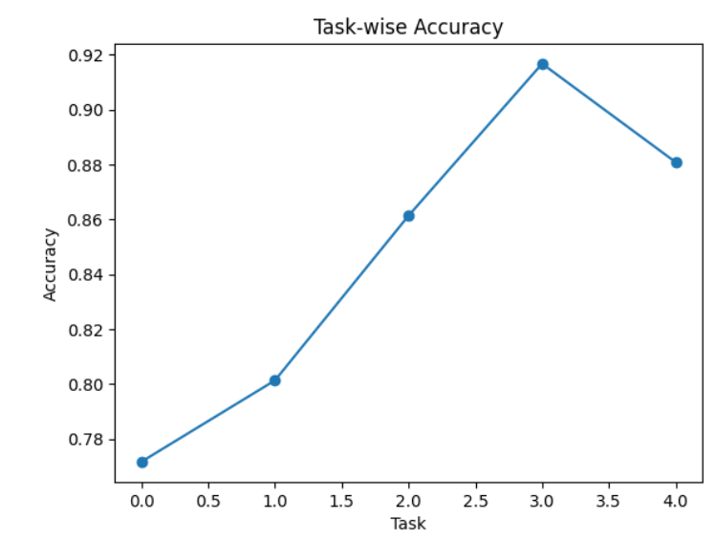
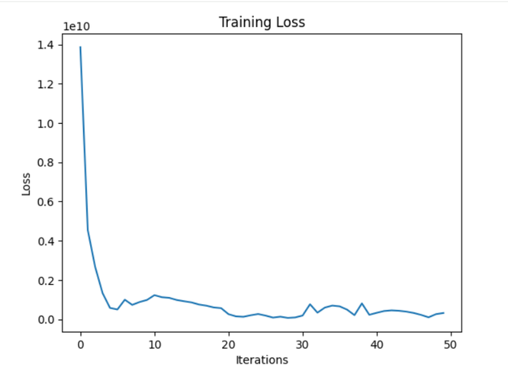
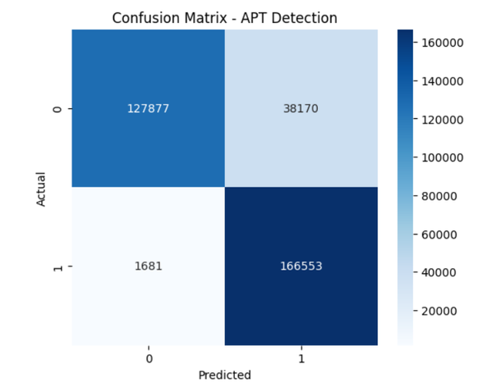
Task-wise Accuracy Curve
Traning Loss Curve
Confusion Metrix

Slide 11
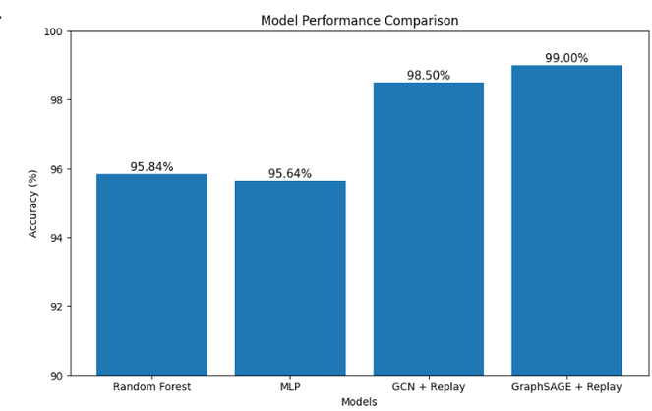
Comparison with Existing Methods
Accuracy / Performance Comparison
Observed Improvements
Better handling of temporal distribution shifts.
Improved adaptive learning capability.
Enhanced robustness against evolving APT attacks.
Advantages of the Proposed Work
Captures structural relationships between network entities.
Adapts to evolving attack patterns.
Reduces catastrophic forgetting.
Supports inductive learning for unseen IP nodes.

Slide 12
Conclusion and Learning Outcomes
Summary of Work Implemented:
Skills and Knowledge Gained:
Implemented graph-based APT detection framework.
Applied rehearsal-based continual learning.
Evaluated GCN, GraphSAGE, and GAT models.
Graph Neural Networks
Continual Learning
Cybersecurity telemetry analysis
Graph construction techniques
PyTorch Geometric implementation
Key Findings:
Key Challenges Faced
Graph learning improves threat detection performance.
Replay memory stabilizes sequential learning.
GraphSAGE achieved the best adaptive performance.
The original research paper used Wazuh EDR telemetry, which was not publicly accessible.
Therefore, the project adapted the framework using the Kaggle APT dataset.

Slide 13
Future Work – Problem Statement
Future Extensions
Improve the GNN model using advanced architectures such as Graph Attention Networks (GAT).
Implement federated continual learning to support multiple decentralized SOC environments securely.
Optimize replay buffer techniques to reduce memory usage and improve long-term scalability.
Enhance the system to detect adversarial and zero-day APT attacks more effectively.
Integrate explainable AI visual dashboards to help security analysts understand model decisions.
Extend the framework for real-time adaptive threat detection using live telemetry streams.
Future Problem Statement
Develop a scalable real-time adaptive APT detection framework using Graph Neural Networks, Continual Learning, and Federated Learning to detect evolving cyber threats across decentralized enterprise environments while preserving data privacy and reducing catastrophic forgetting.

Slide 14
THANK YOU!!

